Slide 1
PY SAGAR_TABLEAU
File created on: 23-03-2021 17:26:04

Slide 2
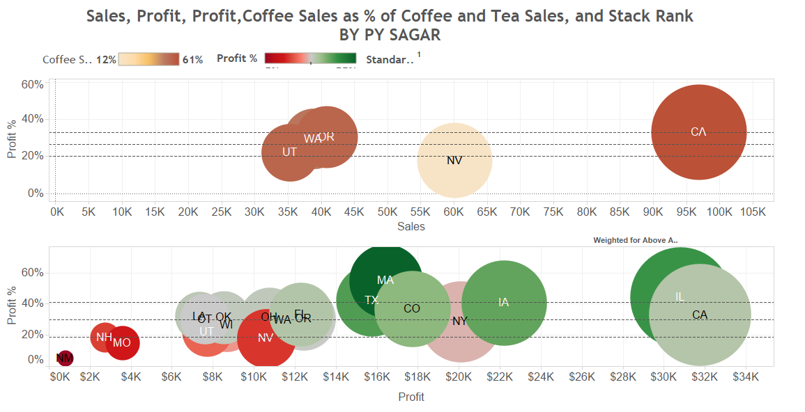

Slide 3
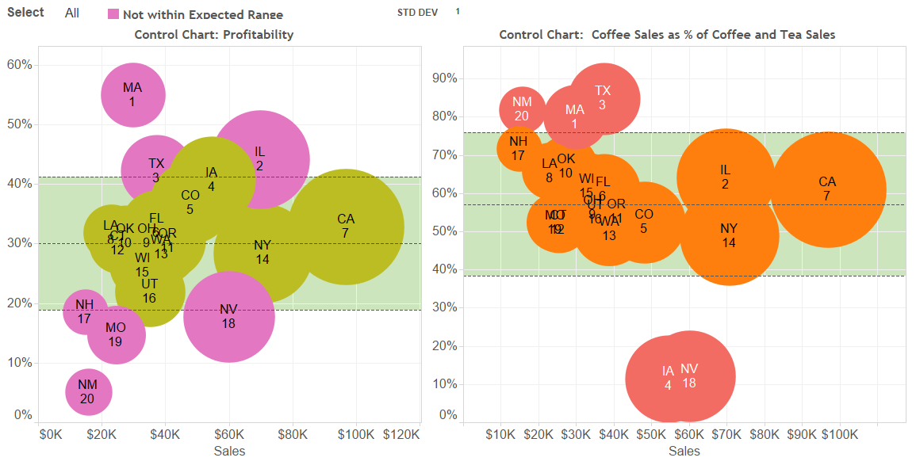

Slide 4
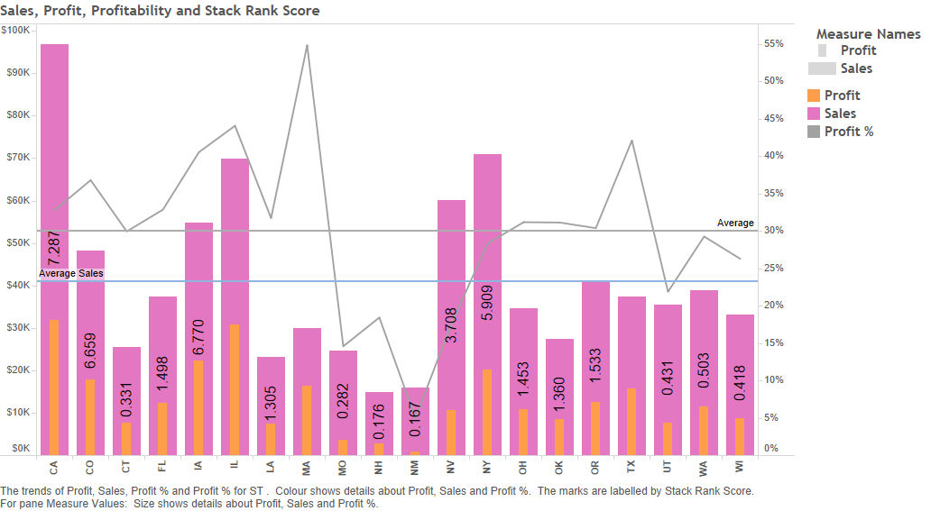

Slide 5
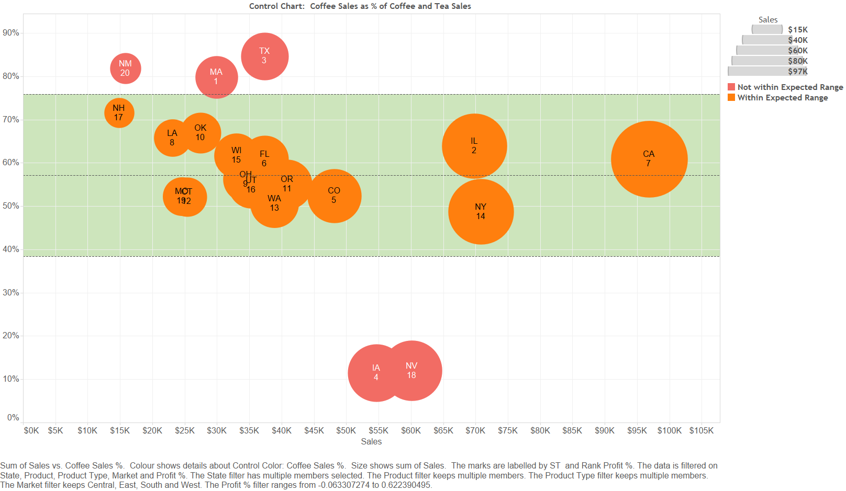

Slide 6
